Slide 1

Remote Procedure Calls
-Rujuta Shah(121044)
OPERATING SYSTEMS
SEMESTER - VI

Slide 2
Introduction: What is RPC ?
In 1984, Birrell and Nelson devised a mechanism to allow programs to call procedures on other machines.
Powerful technology for creating distributed client/server programs.
Interprocess communication technique that allows client and server software to communicate.
It is a protocol that one program can use to request a service from a program located in another computer in a network without having to understand network details. RPC uses the client/server model. The requesting program is a client and the service-providing program is the server.
Example
OPERATING SYSTEMS
SEMESTER - VI
Notes:
For example process on machine A can call a procedure on machine B. The process on A is suspended and execution continues on B . When B returns, the return value is passed to A and A continues execution.

Slide 3
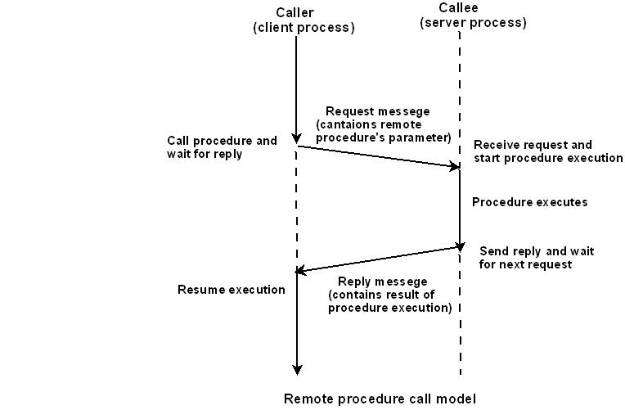
Remote procedure call model
OPERATING SYSTEMS
SEMESTER - VI
Notes:
On arrival of request message, the server processes the following tasks:
extracts the procedure’s parameters,
computes the result,
sends a reply message, and
Then awaits the next call message.

Slide 4
How RPC works?
What is a stub?
Working:
client calls a local procedure, called the client stub
Network messages are sent by the client stub to the remote system
Network messages are transferred by the kernel to the remote system
A server stub process on the server receives the messages.
The server stub calls a local procedure call to the actual server function. passing it the arguments that it received from the client.
Server returns to the server stub with its return values
The server stub converts the return values to a standard format
Messages get sent back across the network to the client stub
The client stub reads the messages from the local kernel.
It then returns the results to the client function
OPERATING SYSTEMS
SEMESTER - VI

Slide 5
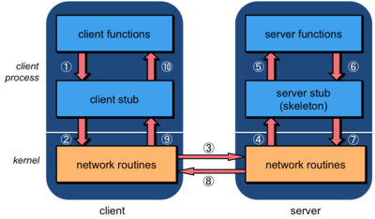
How RPC works?
OPERATING SYSTEMS
SEMESTER - VI

Slide 6
What happens when things go wrong?
There are more opportunities for errors . A server can generate an error, there might be problems in the network, the server can crash, or the client can disappear while the server is running code for it.
The transparency of remote procedure calls breaks here since local procedure calls have no concept of the failure of the procedure call.
Because of this, programs using remote procedure calls have to be prepared to either test for the failure of a remote procedure call or catch an exception.
OPERATING SYSTEMS
SEMESTER - VI

Slide 7
Advantages and Disadvantages
Advantages of RPC:
Server independent
Process-oriented and thread oriented models supported by RPC.
The code re-writing / re-developing effort is minimized.
Enables the usage of the applications used in the distributed environment, not only in the local environment.
Disadvantages of RPC:
Context switching increases scheduling costs
RPC is not a standard – it is an idea that can be implemented in many ways
RPC does not solve the most of the distribution creation problems
RPC is only interaction based. This does not offer any flexibility in terms of hardware architecture.
OPERATING SYSTEMS
SEMESTER - VI

Slide 8
References
http://www.tldp.org/LDP/nag/node128.html
https://technet.microsoft.com/enus/library/cc787851(v=ws.10).aspx
http://www.cs.cf.ac.uk/Dave/C/node33.html
http://www.cse.iitk.ac.in/users/dheeraj/cs425/lec26.html
OPERATING SYSTEMS
SEMESTER - VI

Slide 9
THANK YOU

